Slide 1
Technical Support (420-1N6-AB) User Management
Fall 2021

Slide 2
Outline
Users
Groups
Activities

Slide 3
User Profiles

Slide 4
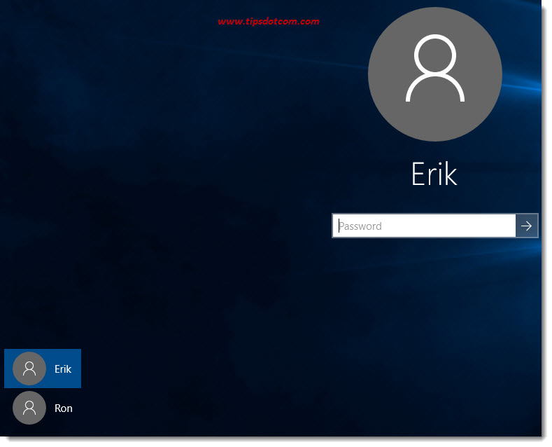
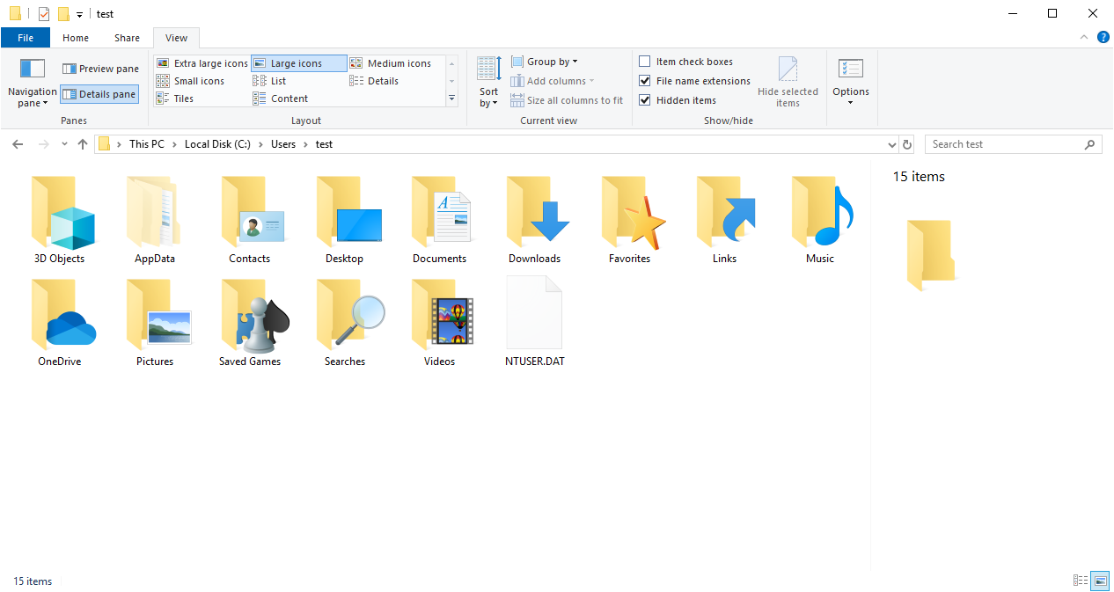
User Profiles – Review
A user profile is created the first time a user logs into a computer.
During subsequent logins, the system loads the user's profile and configures the computer environment according to the information stored in the user profile.

Slide 5
Types of Profiles – Review
Local Profile.
Roaming Profile.
Mandatory Profile.
Temporary Profile.
What are the advantages of having user profiles?
(see https://www.omnisecu.com/windows-2003/group-policy/roaming-profiles-and-mandatory-profiles.php )

Slide 6
User Accounts

Slide 7
User Accounts
A user account is a collection of settings and information that tells Windows which files and folders you can access, what your preferences are, and what network resources you can access when you are connected to a network.
Attributes of a Windows user account:
Username (the name given to the user account)
Password (optional for Windows 7 and below)
User group (collection of accounts that share permissions and rights)
Type (all user accounts have a type which defines what they can do)
Authentication is the process of identifying and granting access to a user.
Authorization is how we determine what an authenticated user is allowed to do.

Slide 8
Types of User Accounts
Administrator
Complete control over the PC.
Can install anything and make changes that affect all users of that PC.
Standard
Can only use the software that is already installed on the PC
Can make changes that affect only themselves.
Guest
Special type of user account for only temporary access to the PC.
Can only use the software that is already installed and cannot change any settings.
Microsoft (Windows 8 and later)
User accounts with an associated e-mail address that gives you access to all Microsoft’s products and services.
Microsoft accounts work on multiple systems and devices. They can be administrators or standard users accounts.
There are benefits and drawbacks to using Microsoft accounts.
Local Account
Classic user accounts that exist locally and can use blank passwords.
Work on a single system only.

Slide 9
Activity: Create Users
On the deployment VM created in the last lab, login as administrator and create the following new users:
Person1
Person2
Person3
Person4
(if you don’t remember how, find the Microsoft documentation -- lots available online)

Slide 10
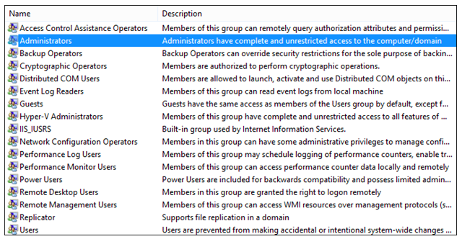
User Groups
A collection of user accounts that share the same security rights and permissions.
Windows has a list of pre-defined user groups, e.g. Administrators / Users.
Each user account has to be a member of at least one user group.
Useful to create user groups as an easy way of maintaining new/existing users in a business setup.

Slide 11
User Groups
Default Windows User Groups:
Administrators
Any account that is a member of this group has complete administrator privileges.
Complete control over the machine.
Power Users
These users are almost as powerful as Administrators but cannot install new devices or access other users’ files/folders.
Users
These users cannot access the Registry or critical system files.
Guests
This group allows users who do not have an account on the system to log on using a guest account. This could include a casual user like a visitor.

Slide 12
Creating User Groups
Imagine a small business with a network of shared computers.
There are two staff members who administer the payroll;
There are three bosses who oversee the running of the entire business;
There are eight engineers who work on sensitive data;
There are two administration assistants.
The data files are kept in folders as follows:
Payroll, EngineeringData, TimeSheets, BusinessProposals
Only the bosses and payroll personnel should have access to the payroll data.
Only engineers and bosses should have access to the sensitive data.
Only admin assistants and bosses should have access to timesheets and business proposals.

Slide 13
User Groups
User Group | Access To Folders
Bosses | Payroll, EngineeringData, TimeSheets, BusinessProposals
Payroll Staff | Payroll, TimeSheets
Engineers | EngineeringData
Administration Assistants | TimeSheets, BusinessProposals

Slide 14
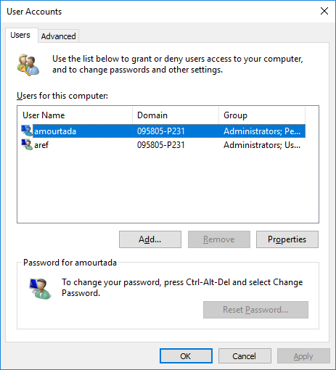
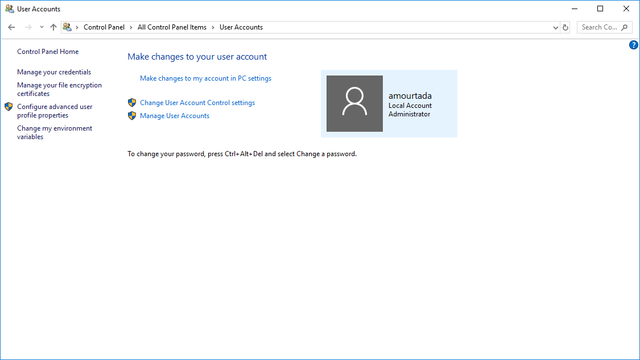
Users And Groups In Windows 10
Control Panel → User Accounts → Manage User Accounts or
Computer → Right-Click → Manage → Local Users & Groups

Slide 15
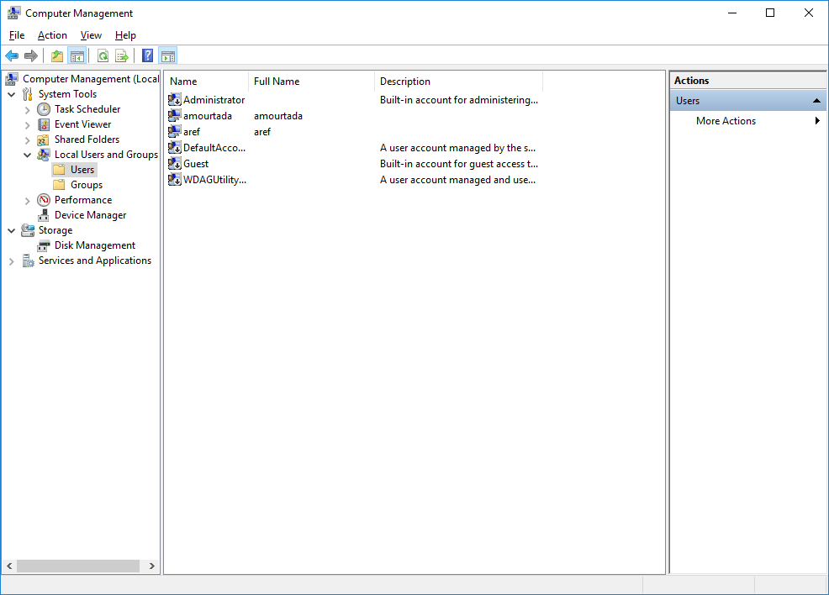
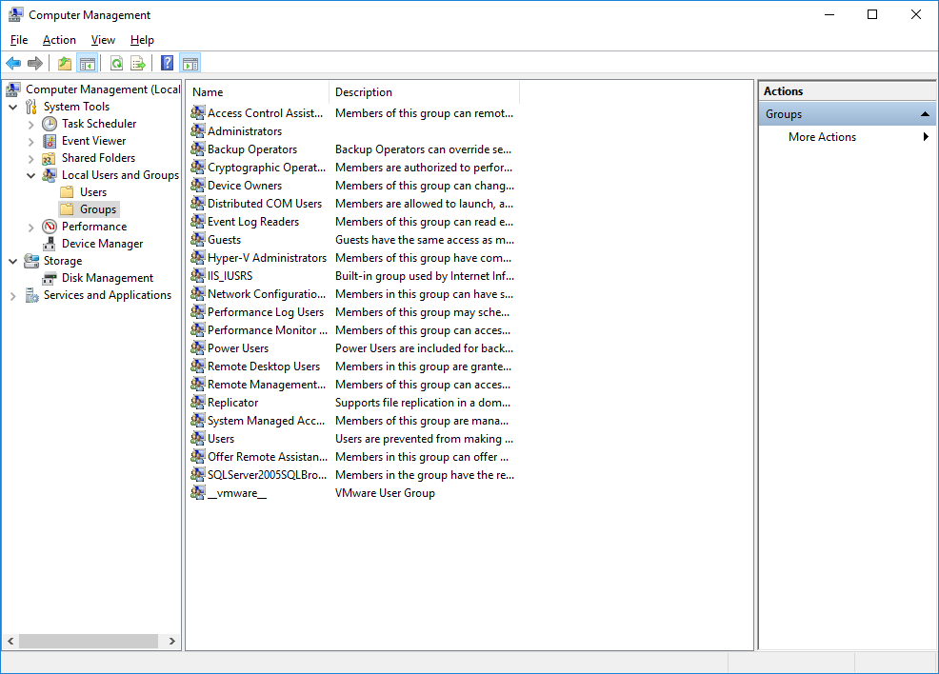
Users & Groups

Slide 16
Activity: Create Groups
On the deployment VM.
As administrator, Create the following new groups:
GroupA
GroupB
Add Person1 and Person2 to GroupA.
Add Person2, Person3 and Person4 to GroupB.

Slide 17
Passwords
Most people use passwords that are amazingly easy to hack!
A “strong” password is:
at least 8 characters long
includes letters, UPPER and lower case, numbers, and punctuation symbols. Using non-alphanumeric characters makes any password much harder to crack for two reasons:
Hacker has to consider more possible characters than just letters/numbers.
Most password crackers use a combination of common words and numbers.
You should also change your password at regular intervals.
These rules can be set as a password policy on operating system or network, forcing all users to conform to them.
Best practise: use a password manager!
my personal favourite: https://www.passwordstore.org/
others: https://www.tomsguide.com/us/best-password-managers,review-3785.html

Slide 18
Passwords
https://www.youtube.com/watch?v=7U-RbOKanYs (to see how password cracking works)

Slide 19
Most Common Passwords
123456
123456789
qwerty
password
111111
12345678
abc123
1234567
password1
12345

Slide 20
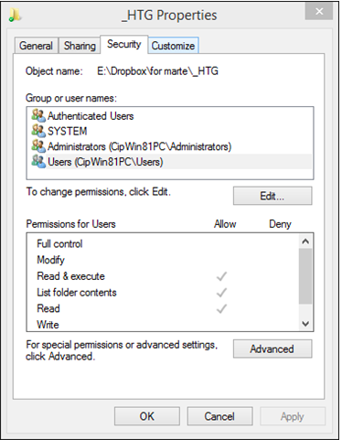
Permissions
Permissions are a way of assigning access rights to user accounts and groups.
Windows uses the permissions to define what a user can do with files and folders.
To learn the permissions of any folder, right-click on it and select “Properties”. Then click on the “Security” tab.

Slide 21
User accounts & Groups Permissions
Read | Allows viewing and listing of a file and folder.
Write | Allows writing to a file, or adding files and subfolders to a folder.
List folder contents | Only for folders, allows the viewing and listing of files and subfolders, also executing files that are in the folder.
Read and execute | Allows reading and accessing a file’s contents as well as executing. With folders it allows the viewing and listing of files and subfolders as well as executing files.
Modify | Allows reading, writing and deletion of files. Allows reading and writing of files and subfolders, plus deletion of the folder.
Full control | Allows reading, writing, changing and deleting of any file and subfolder,
Files generally inherit the permissions of the folder where they are placed. But you can also specify permissions on a file level (folder level recommended).

Slide 22
How Permissions Work
A new file inherits the permissions from the folder it is placed in.
If a file has been copied from somewhere else, it inherits the permissions from the folder that it is placed in
So it is different from the original permissions.
If a file has been moved, it keeps its original permissions.
Unless it has been moved to a different partition, e.g. C:\ to D:\.
This is because moving across partitions isn’t really moving, it makes a copy, so permissions are like copied file.
If a file is moved to a FAT system (e.g. USB devices are typically FAT) then there will be no permissions associated with that file.

Slide 23
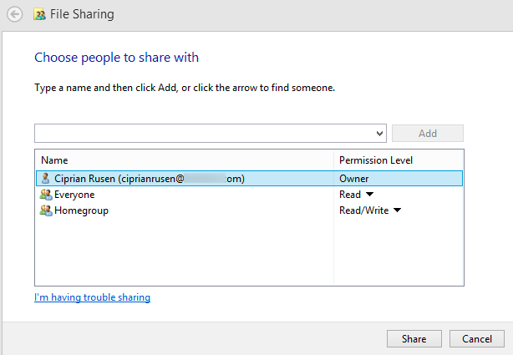
Why Are Permissions Important?
When you share something in Windows you are actually assigning a set of permissions to the user account or group.
A shared folder can only be accessed by someone with a user account that has permission to access that folder.

Slide 24
Activity: Granting Permissions
On the deployment VM. As administrator:
Create a folder Section2Test (on the D drive).
Check the inherited permissions for this folder.
What about Authenticated Users? Modify as appropriate.
Inside the Section2Test folder, create the following new folders:
FolderA
FolderB
FolderC

Slide 25
Activity: Granting Permissions (cont.)
Grant permissions to these folders as follows:
FolderA - GroupA has complete access; GroupB can read and see folder listing only.
FolderB - GroupB has complete access; GroupA can read and see folder listing only.
FolderC - Both GroupA and GroupB have complete access.

Slide 26
Activity: Granting Permissions (cont.)
Log in as Person2,
Create two files in “Testing\FolderA”
Create two files in “Testing\FolderB”
Create two files in “Testing\FolderC” Why can Person2 create files in all three folders?
Log in as Person3,
Verify that Person3 can read the files created in “Testing\FolderA” but not modify it.
Verify that Person3 can read and modify the files created in “Testing\FolderB”
Verify that Person3 can read and modify the files created in “Testing\FolderC”
Log in as Person1,
Verify that Person1 can read and modify the files created in “Testing\FolderA”
Verify that Person1 can read the files created in “Testing\FolderB” but not modify it.
Verify that Person1 can read and modify the files created in “Testing\FolderC”

Slide 27
Parental Controls
Time Limits
You can set users to have specific times/days when they can log in.
Games
You can define whether the user is allowed to play games, which game ratings are acceptable, and whether unrated games can be played. You can also block or allow specific games.
Allow and Block Specific Programs
You can also limit access to specific applications if necessary.

Slide 28
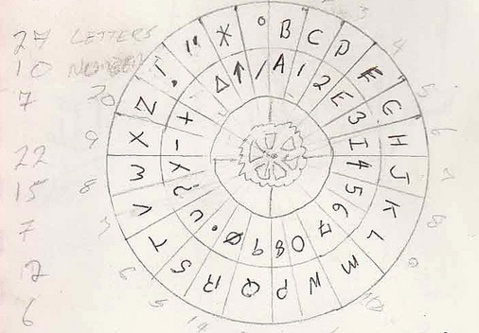
Encryption
Encryption is a way of protecting data from people you don’t want to see it.
Similar to “decoder rings” you probably played with as a kid.
You have a message you to keep secret, you encode it using a secret cipher, only people with the cipher can read it. Anyone else just sees nonsense.
This is simplified explanation… Different types of encryption use a more complex form such as multiple “decoder rings”.

Slide 29
When should I encrypt files and folders?
If the answer to “Would it be a problem if this data was made available to others”? is yes, then yes
Things to keep in mind:
Back up your encryption certificate and key and store them in a safe place.
If you encrypt a folder, all files in that folder will automatically be encrypted.
Encryption tools will work differently from operating system to operating system. Make sure you read the documentation of the tool you are using to understand how it works.

Slide 30
Activity: Encryption
Log in as Person1, Encrypt the folder “Section2Testing\FolderA”
Log in as Person2 and verify that Person2 can see but not open any files in FolderA.
Log in as Person1, Copy the files in FolderA to a USB device. Can Person2 open them now?

Slide 31
User Account Control
Windows feature that informs you when a program makes a change that requires administrator-level permission.
You are logged in as a standard user. When changes are going to be made to your computer that require administrator-level permission, UAC notifies you. You then need to enter an administrator password to continue.
This allows temporary permission to complete the task. After that the permissions revert back to those of a standard user.
No changes can be made to your computer without you knowing about it. (This can help to prevent malware and spyware from being installed).

Slide 32


User Account Control
Icon | Type | Description
 | A setting or feature that is part of Windows needs your permission to start. | This item has a valid digital signature that verifies that Microsoft is the publisher of this item. If you get this type of dialog box, it's usually safe to continue.
 | A program that is not part of Windows needs your permission to start. | This program has a valid digital signature, which helps to ensure that the program is what it claims to be and verifies the identity of the publisher of the program. If you get this type of dialog box, make sure the program is the one that you want to run and that you trust the publisher.

Slide 33


User Account Control
Icon | Type | Description
 | A program with an unknown publisher needs your permission to start. | This program doesn't have a valid digital signature from its publisher. This doesn't necessarily indicate danger, as many older, legitimate programs lack signatures. However, you should use extra caution and only allow a program to run if you obtained it from a trusted source, such as the original CD or a publisher's website.
 | You have been blocked by your system administrator from running this program. | This program has been blocked because it is known to be untrusted. To run this program, you need to contact your system administrator.

Slide 34
Q & A
Notes:
In Slide Show mode, click the arrow to enter the PowerPoint Getting Started Center.

